Slide 1
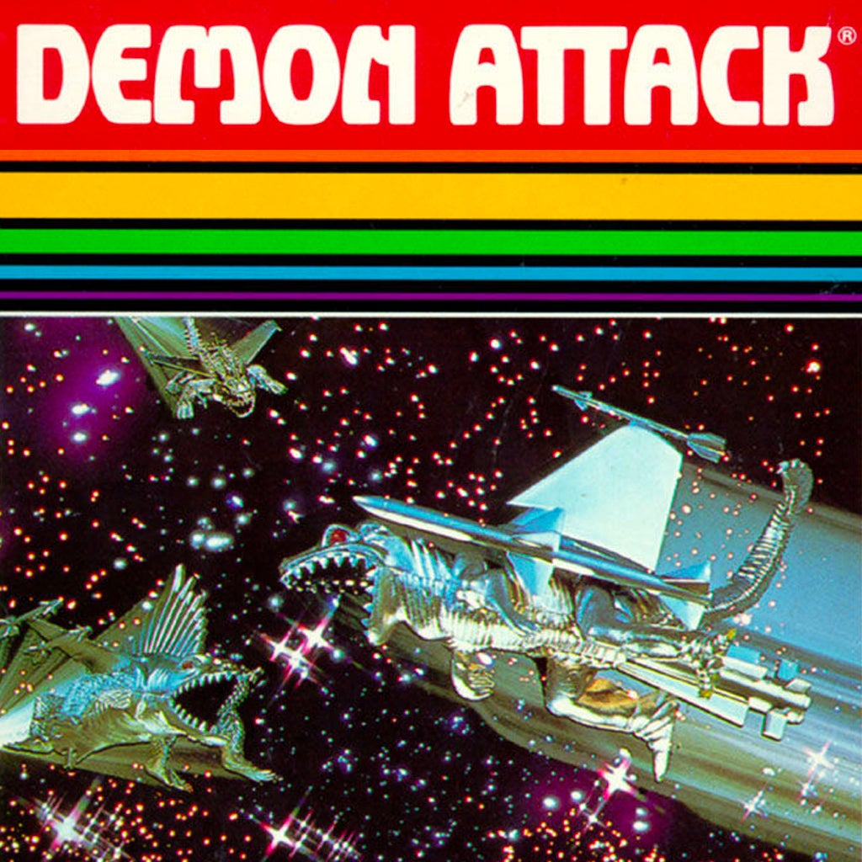
DQN: Demon Attack
Atari Domain
By: Nathaniel and Alexander Madrigal

Slide 2
Agenda
Environment
Demo
DQN Extensions
Hyperparameter Experimentation
Next Steps

Slide 3
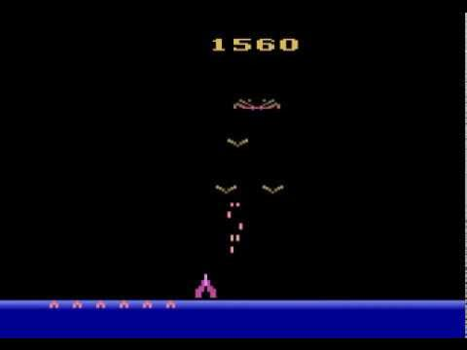
Environment
“ALE/DemonAttack-v5”
Rewards
Points are given for killing demons
Not time based or # of bunkers
Stochasticity
“Sticky” actions (25%)
Enemy behavior

Slide 4
Environment
Action | Meaning | Description
0 | NOOP | Do nothing
1 | FIRE | Shoot laser cannon
2 | RIGHT | Move right
3 | LEFT | Move left
4 | RIGHTFIRE | Move right and shoot
5 | LEFTFIRE | Move left and shoot

Slide 5
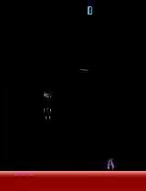
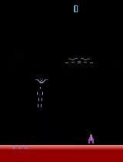
Demo
Slightly trained: 50 reward
DDQN + Dueling: 475 reward

Slide 6
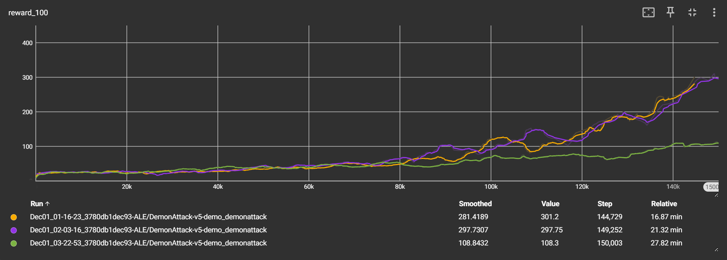
DQN Extensions
Mean Reward / Step
Orange and Purple have similar rewards
Green performs poorly
Baseline
DDQN + Dueling DQN
Double + Dueling DQN + N-step Results

Slide 7
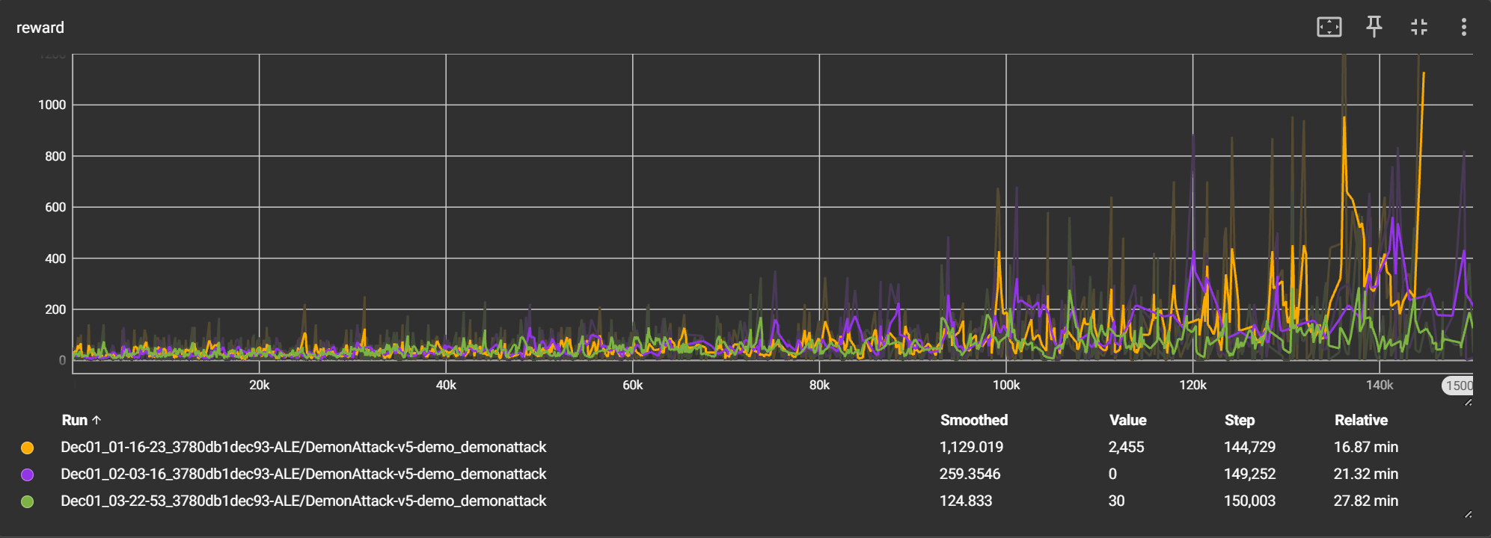
DQN Extensions
Reward / Step
Purple is smoother than Orange
Baseline
Double + Dueling DQN
Double + Dueling DQN + N-step Results

Slide 8
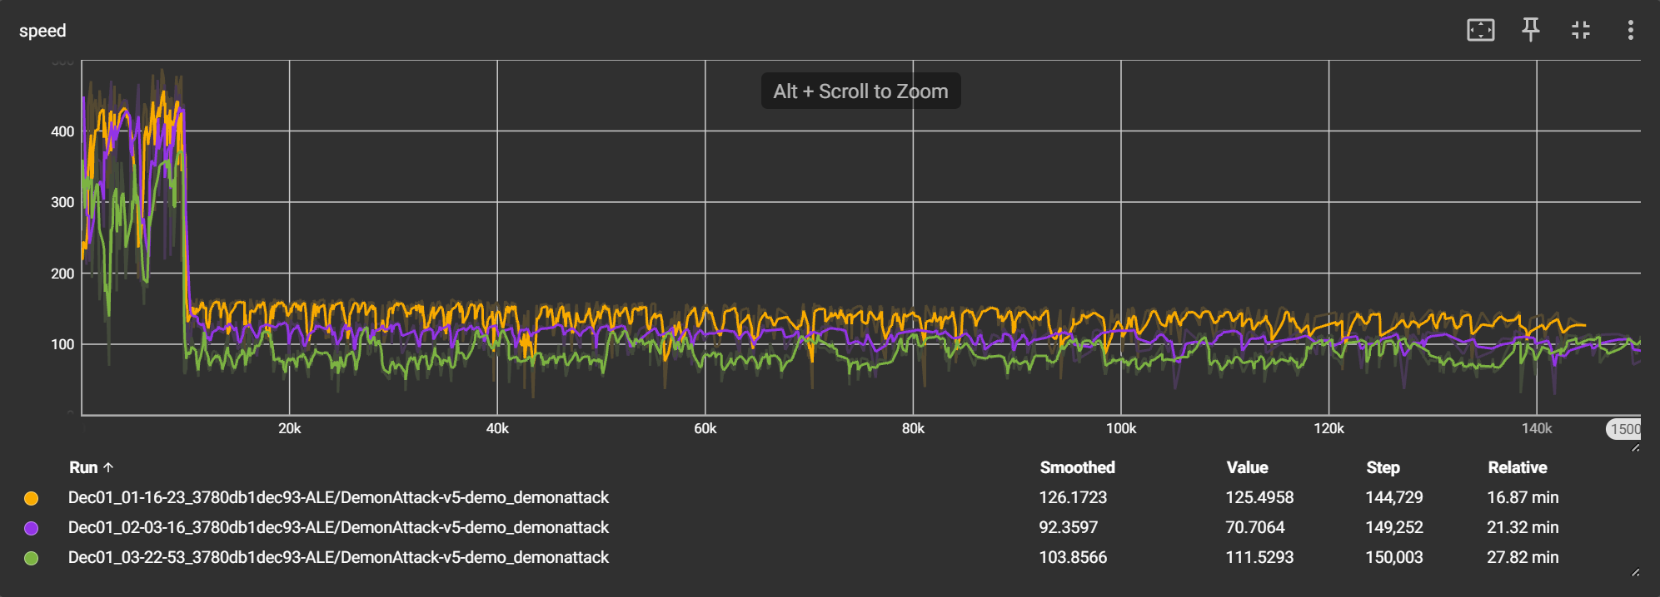
DQN Extensions
Speed (frame per second) / Step
Orange > Purple > Green
Baseline
Double + Dueling DQN
Double + Dueling DQN + N-step Results

Slide 9
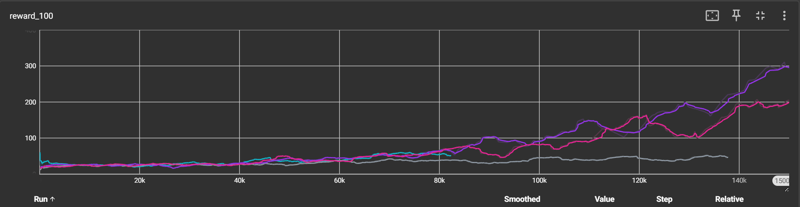
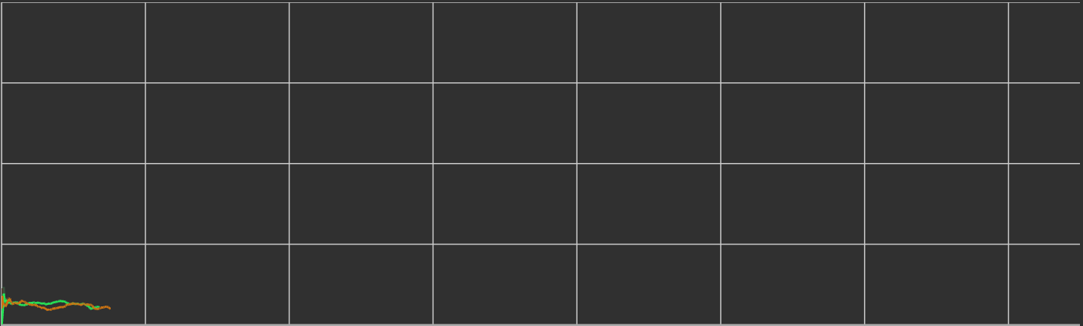
Hyperparameter Experimentation
Baseline: Learning rate=1e-4 , Gamma=0.99, Epsilon decay=150000, Replay size=10000, Batch size=32
Epsilon decay: 150000 -> 300000 (slower early learning)
Learning rate: 1e-4 -> 2e-4 (faster, less stable)
Gamma: .99 -> .97 (more weight on short-term reward)
Replay size: 10000 -> 50000 (slower, more stable)
Batch Size: 32-> 64 (slower, more stable)
Mean reward / Step

Slide 10
Next Steps
Reward shaping:
Penalized for losing bunkers
Penalized for amount of time idle
Rewarded for clearing waves
Potential outcomes:
More frequent feedback -> faster convergence
More human-like playing
Careful but aggressive

Slide 11
Thank you

